Slide 1
Design of a RLNC implementation on the switch

Slide 2
Modules
Network Coding Module
Recoding submodule
Coding Submodule
Decoding Module
Buffering Module
Forwarding Module

Slide 3
Buffering Module
Core objective:
To store the symbols in the switch needed for future encoding opportunities.
Challenges:
Indexing the symbols.
Keeping track of where each symbol is.
Handling a large number of symbols
No loops, can’t iterate over registers
No way to efficiently fetch the necessary symbols
Solutions:
Implementation of a circular buffer, to re-use space.
Index the symbols based on its generation, separately allocate buffer space for each different generation.
Limit the number of symbols that can be buffered at the same time
Buffering Module

Slide 4
Network Coding Module
Core objective:
To implement a Random Linear Coding solution on the switch’s data plane.
Design Choice N.º1 – Choosing the type of RLNC:
Generation based RLNC
More common
High in-order delivery delay
Multiple approaches to implement this (e.g. multigeneration,
Need to create generations
Sliding Window RLNC
Newer approach to RLNC
Good for streaming applications
Low in-order delivery delay
Network Coding Module

Slide 5
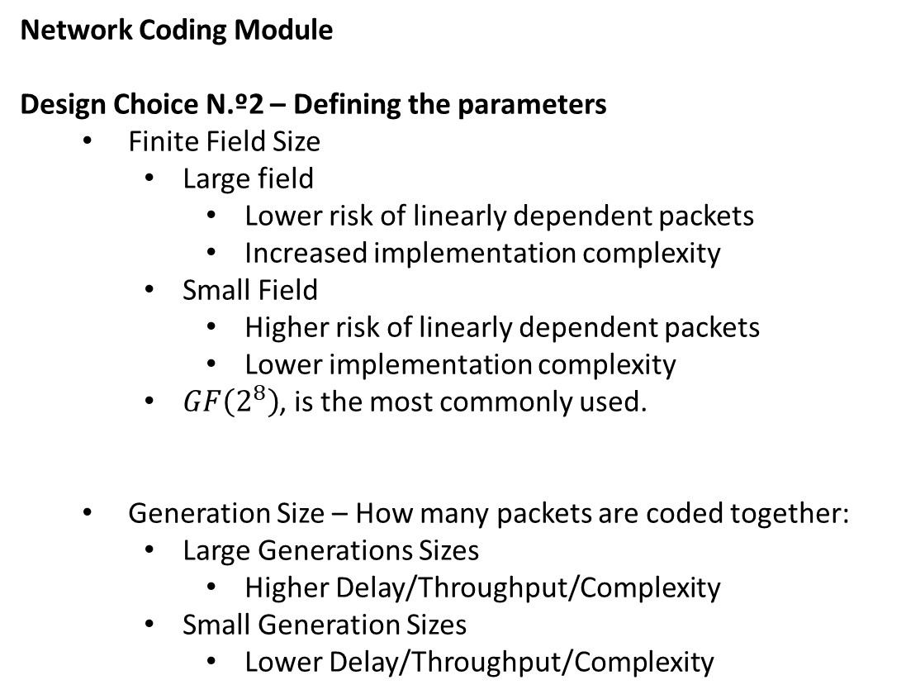
Network Coding Module
Design Choice N.º2 – Defining the parameters
Finite Field Size
Large field
Lower risk of linearly dependent packets
Increased implementation complexity
Small Field
Higher risk of linearly dependent packets
Lower implementation complexity
$GF\left(2^{8}\right)$, is the most commonly used.
Generation Size – How many packets are coded together:
Large Generations Sizes
Higher Delay/Throughput/Complexity
Small Generation Sizes
Lower Delay/Throughput/Complexity
Network Coding Module

Slide 6
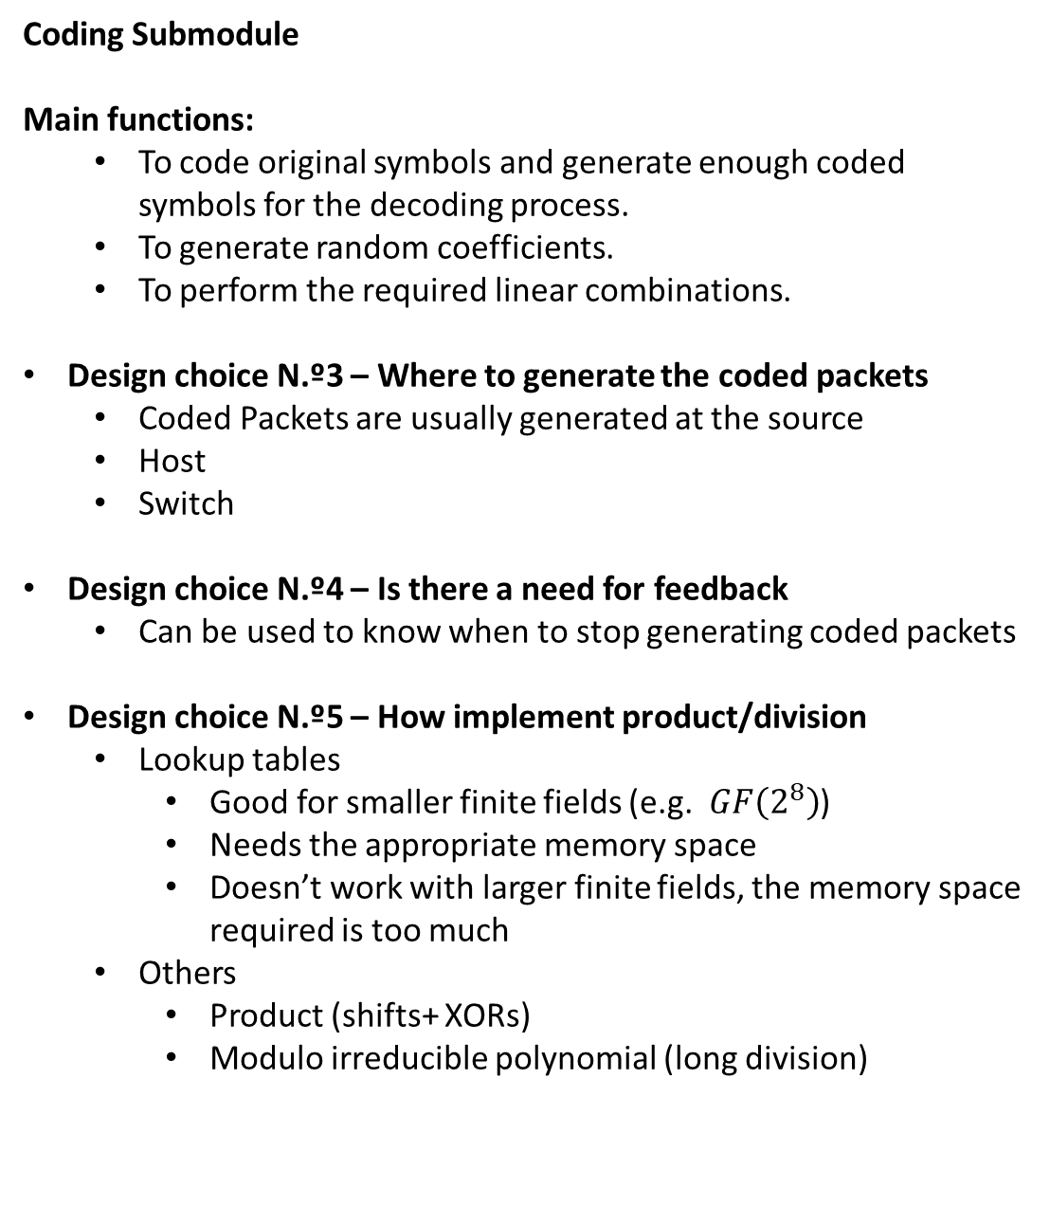
Coding Submodule
Main functions:
To code original symbols and generate enough coded symbols for the decoding process.
To generate random coefficients.
To perform the required linear combinations.
Design choice N.º3 – Where to generate the coded packets
Coded Packets are usually generated at the source
Host
Switch
Design choice N.º4 – Is there a need for feedback
Can be used to know when to stop generating coded packets
Design choice N.º5 – How implement product/division
Lookup tables
Good for smaller finite fields (e.g. $GF\left(2^{8}\right)$)
Needs the appropriate memory space
Doesn’t work with larger finite fields, the memory space required is too much
Others
Product (shifts+ XORs)
Modulo irreducible polynomial (long division)
Network Coding Module
Coding Submodule

Slide 7
Recoding Submodule
Main functions:
To code once again the coded symbols.
To update the coding coefficients.
To update the coded symbols.
Same design choices as the coding submodule
Network Coding Module
Recoding Submodule

Slide 8
Decoding Submodule
Main functions:
To decode the coded symbols, producing the originals ones.
To check for linear independency
To perform Gaussian Elimination
Design choice N.º6 – Checking for linear independency
Possible on a switch?
Design choice N.º7 – Solving the linear equations (decoding)
Possible on a switch?
Network Coding Module
Decoding Submodule

Slide 9
Forwarding Module
Core objective:
To forward the packet to the next node according to some forwarding policy
Forwarding Module

Slide 10
References
S. Wunderlich, F. Gabriel, S. Pandi, F. H. P. Fitzek and M. Reisslein, "Caterpillar RLNC (CRLNC): A Practical Finite Sliding Window RLNC Approach," in IEEE Access, vol. 5, pp. 20183-20197, 2017. doi: 10.1109/ACCESS.2017.2757241
M. V. Pedersen, D. E. Lucani, F. H. P. Fitzek, C. W. Sørensen and A. S. Badr, "Network coding designs suited for the real world: What works, what doesn't, what's promising," 2013 IEEE Information Theory Workshop (ITW), Sevilla, 2013, pp. 1-5.
Torre R., Pandi S., Fitzek F.H.P. (2019) Network-Coded Multigeneration Protocols in Heterogeneous Cellular Networks. In: Sucasas V., Mantas G., Althunibat S. (eds) Broadband Communications, Networks, and Systems. BROADNETS 2018. Lecture Notes of the Institute for Computer Sciences, Social Informatics and Telecommunications Engineering, vol 263. Springer, Cham

